Slide 1
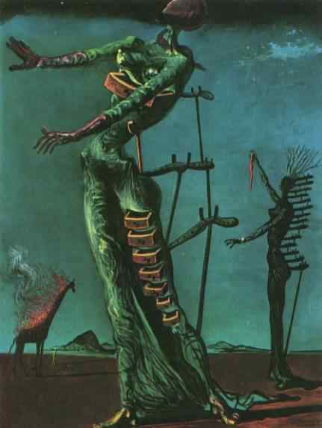
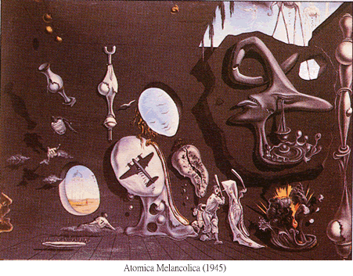
Surrealism 1924

Slide 2
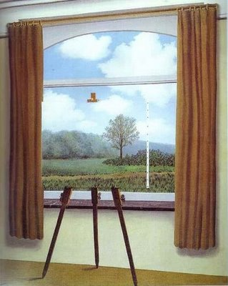
Surrealism 1924
Originally a literary movement, it explored dreams, the unconscious, the element of chance and multiple levels of reality.
“more than real”
“better than real”

Slide 3
WHY Surrealism in 1924?
What was happening in the world around this time?

Slide 4
WHY Surrealism in 1924?
What was happening in the world around this time?
World War I (1914-1918)
Sigmund Freud

Slide 5
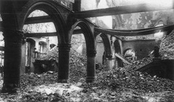
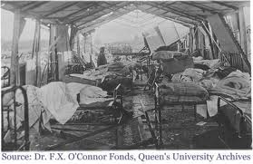
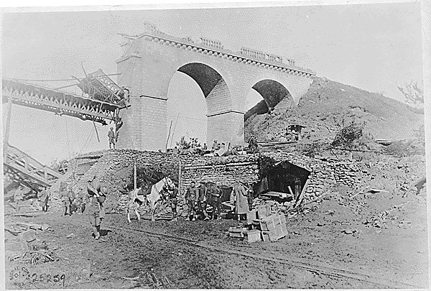
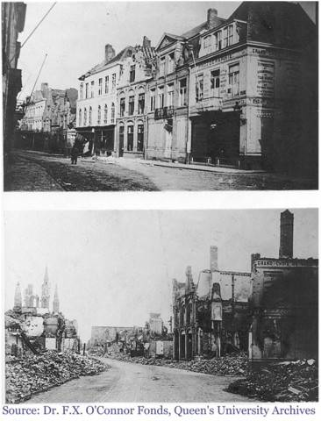
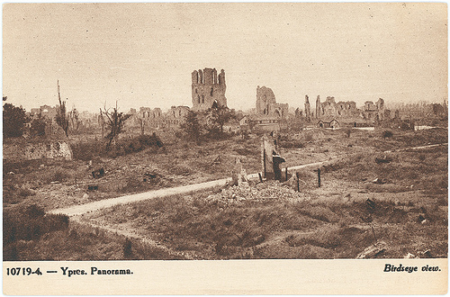
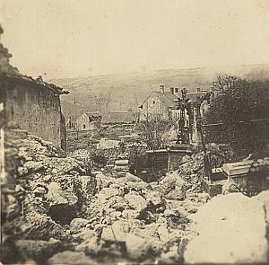
Physically and psychologically,
WWI destroyed Western civilization
Countries Involved:
Australia
Austria
Belgium
Bulgaria
Canada
France
Germany
Great Britain
Greece
India
Iraq
Italy
Japan
Montenegro
New Zealand
Poland
Portugal
Rhodesia
Romania
Russia
Serbia
South Africa
Turkey
United States

Slide 6
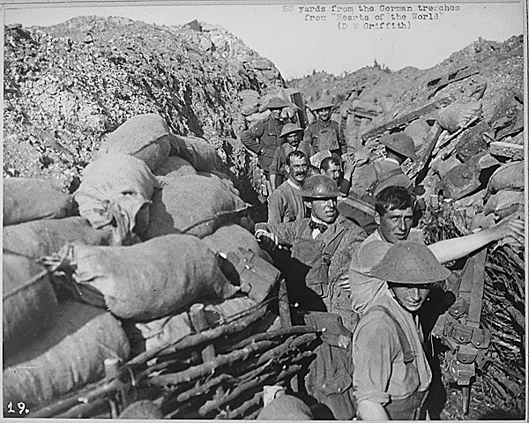
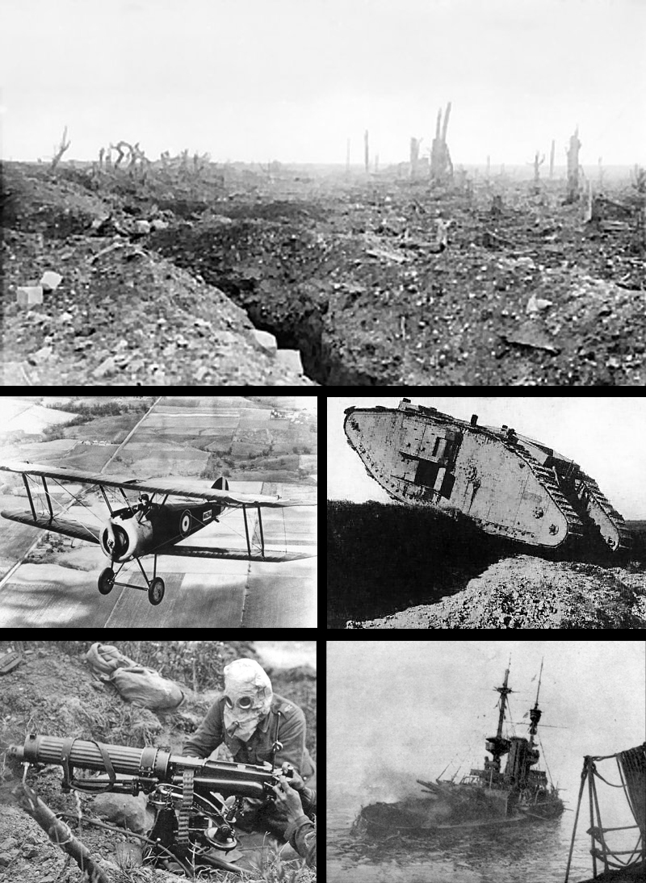
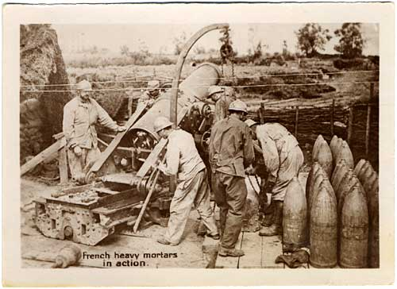
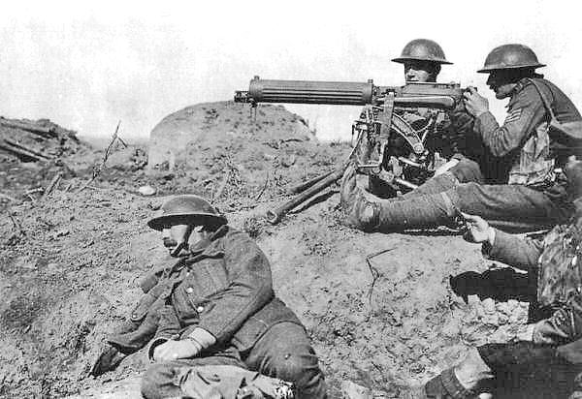
“The logic, science and technology that many thought would bring a better world had gone horribly wrong.
Instead of a better world, the advancements of the 19th century had produced such high tech weapons as machine guns, long-range artillery, tanks, submarines, fighter planes and mustard gas.”
(source: Janson)

Slide 7
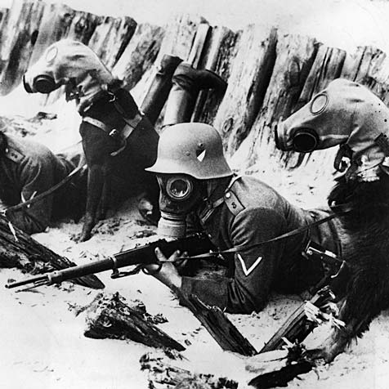
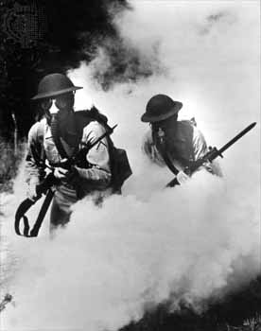
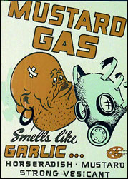
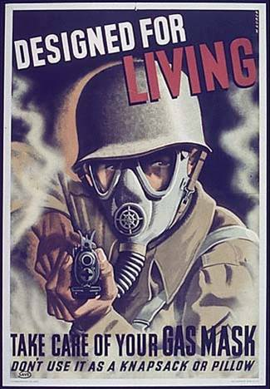
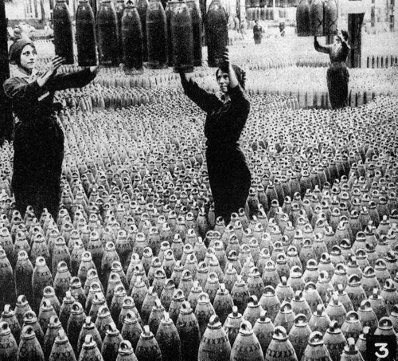

Slide 8
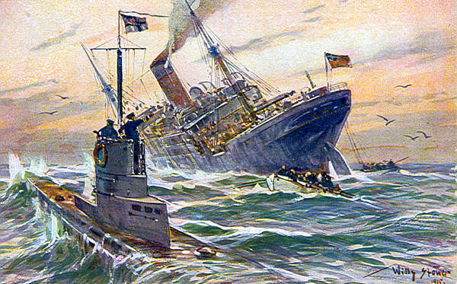
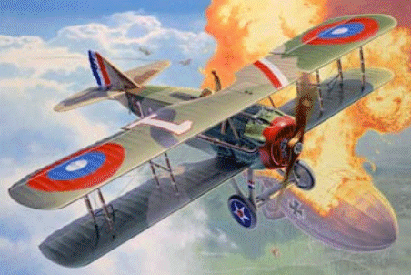
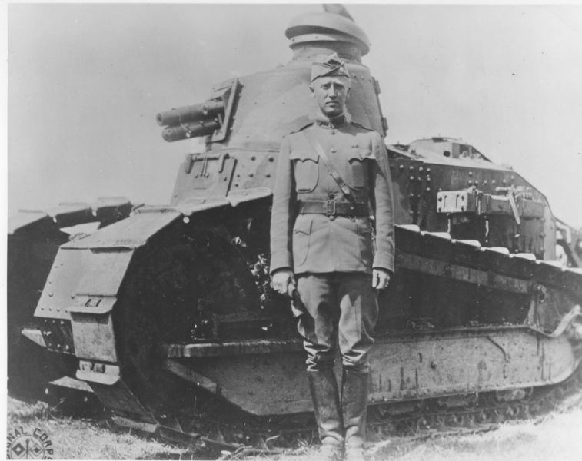
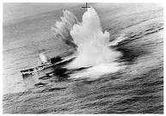

Slide 9
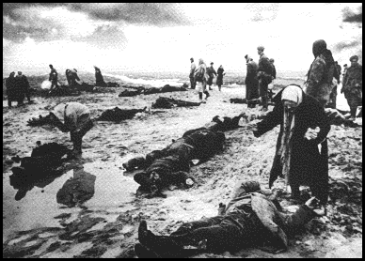
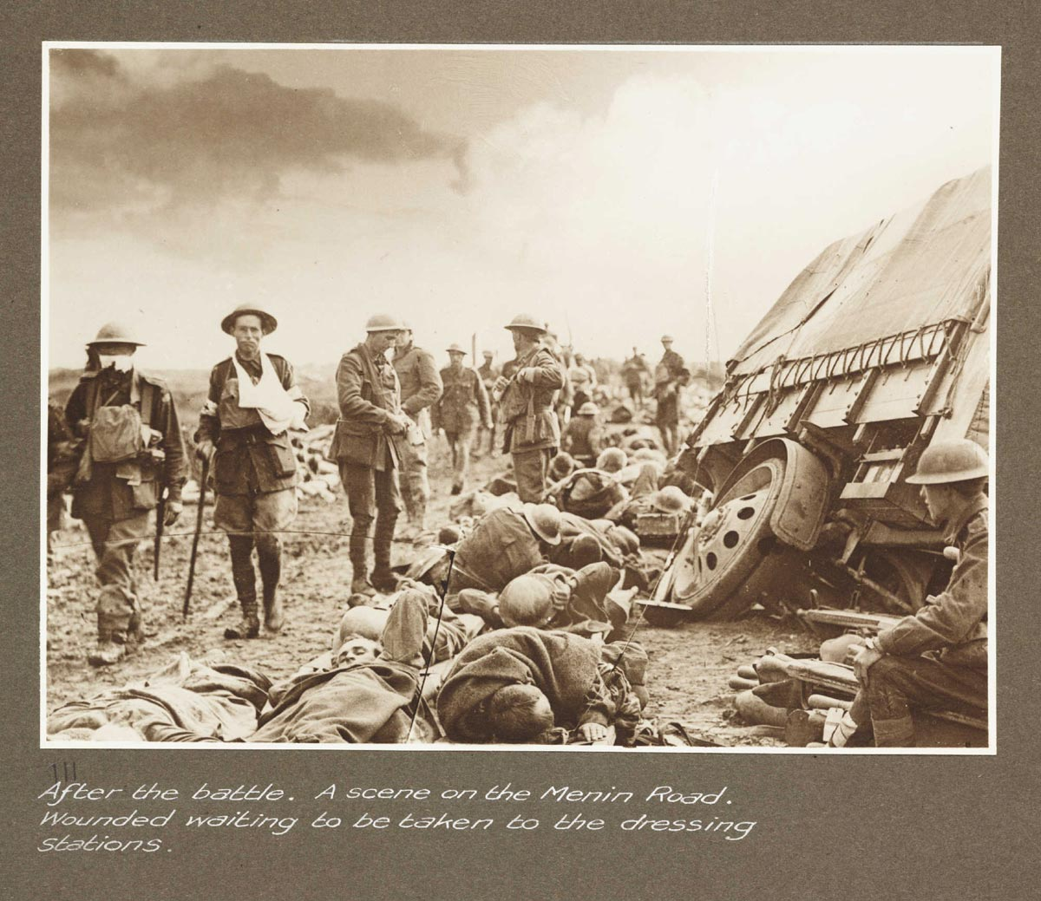
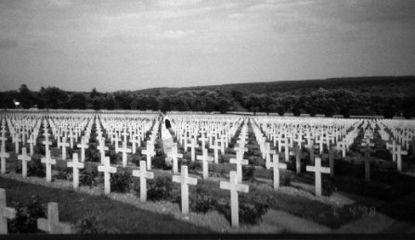
Staggering destruction and loss of life
TOTAL WWI CASUALTIES: 11,016,000

Slide 10
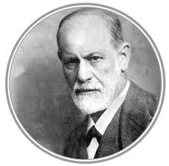
Sigmund Freud (1856-1939)
The father of psychoanalysis
In 1900, Freud published The Interpretation of Dreams, and introduced the wider public to the notion of the unconscious mind
theorized that forgetfulness or slips of the tongue (now called "Freudian slips") were not accidental at all, but it was the "dynamic unconscious" revealing something meaningful.
He said “Dreams are often most profound when they seem the most crazy.”

Slide 11
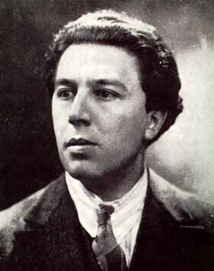
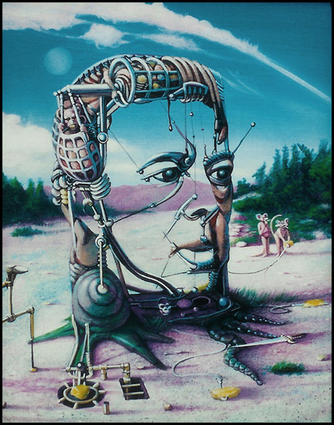
Andre Breton Poet
“Surrealism is based on the belief in the superior reality of the dream”

Slide 12
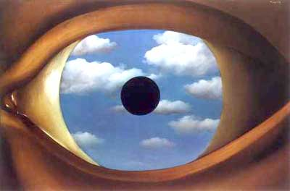
Surreal
Odd
Illogical
Irrational
Exciting
Disturbing

Slide 13
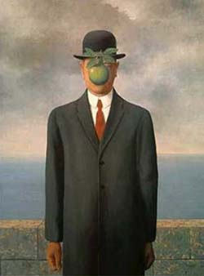
Characteristics of Surrealism
Reaction to chaos of WWI
Influence of Freud: Dreams and subconscious
Impossible scale
Reversal of natural laws
Double images
Juxtaposition

Slide 14
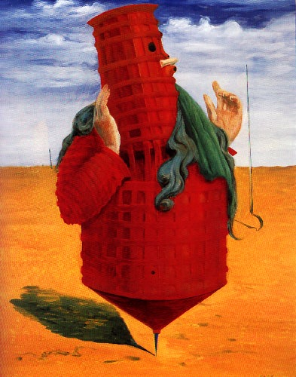
Where? France, Germany, Catalunya, Belgium Artists Max Ernst Salvador Dali Joan Miro Man Ray Rene Magritte

Slide 15
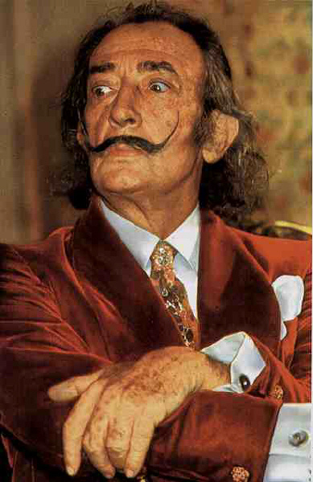
Salvador Dali
(Spanish, 1904–1989)

Slide 16
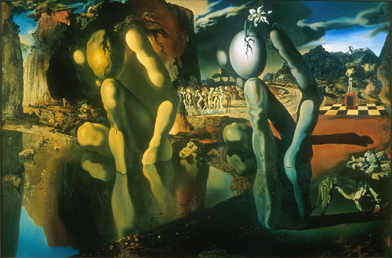
The Metamorphosis of Narcissus, 1937, Salvador Dali

Slide 17
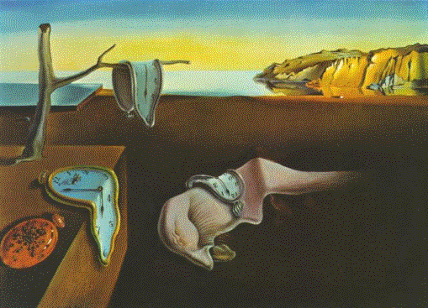
Salvador Dali Persistence of Memory 1931

Slide 18
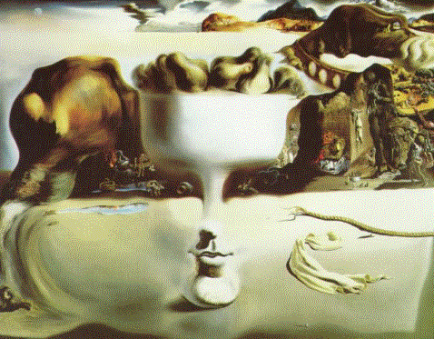
Salvador Dali Apparition

Slide 19
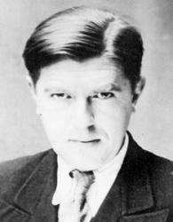
Rene Magritte (Belgian)

Slide 20
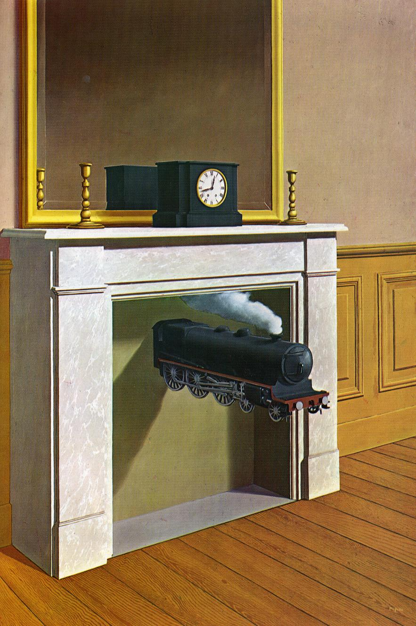
Rene Magritte

Slide 21
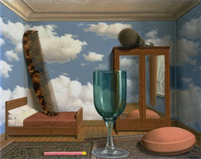
René Magritte Les valeurs personnelles (Personal Values) 1952

Slide 22
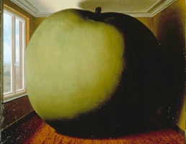
René Magritte La Chambre d'écoute (The Listening Room) 1952 (impossible scale)

Slide 23
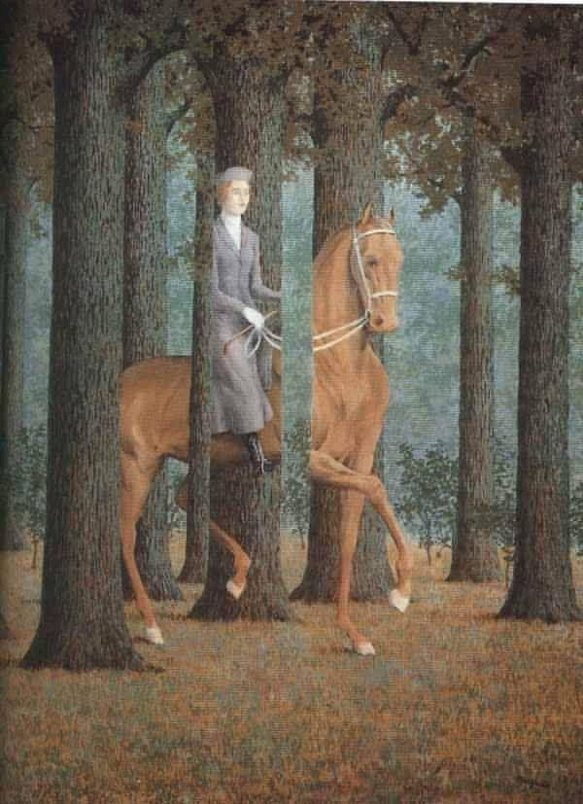
Rene Magritte Carte Blanche
“Carte Blanche,” Rene Magritte

Slide 24
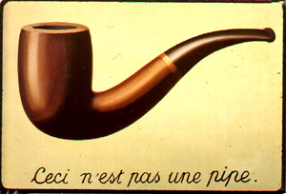
Concepts of unconscious realities and dream interpretation in Surrealism is further emphasized by Sigmund Freud's contributions to the new order of thought.
Rene Magritte Ceci n’est pas une pipe

Slide 25
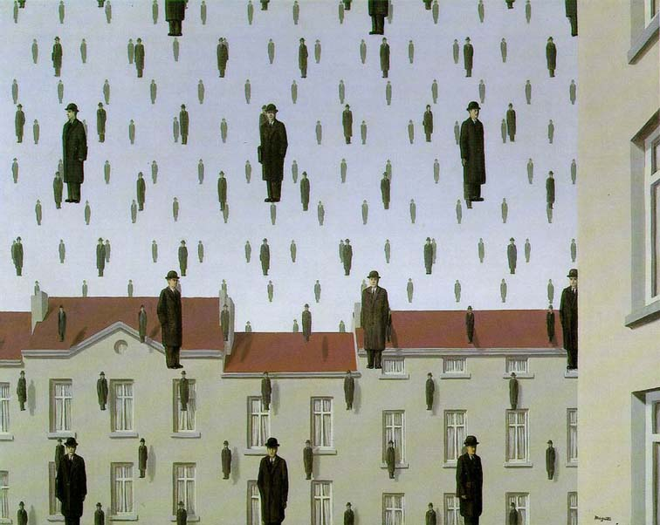
Rene Magritte (Reversal of Natural Laws)

Slide 26
Ideas for your Surrealist Collage and Painting a) change the normal scale of objects (ex: a car the size of a living room or bugs the size of people) b) turn the accepted order of things upside down (ex: dogs walking people instead of people walking dogs) c) mix internal and external space (ex: trees growing in a kitchen, seeing the inside and outside of an object at the same time) d) transform one object into another (ex: a car turning into a fish, an animal turning into a person)

Slide 27
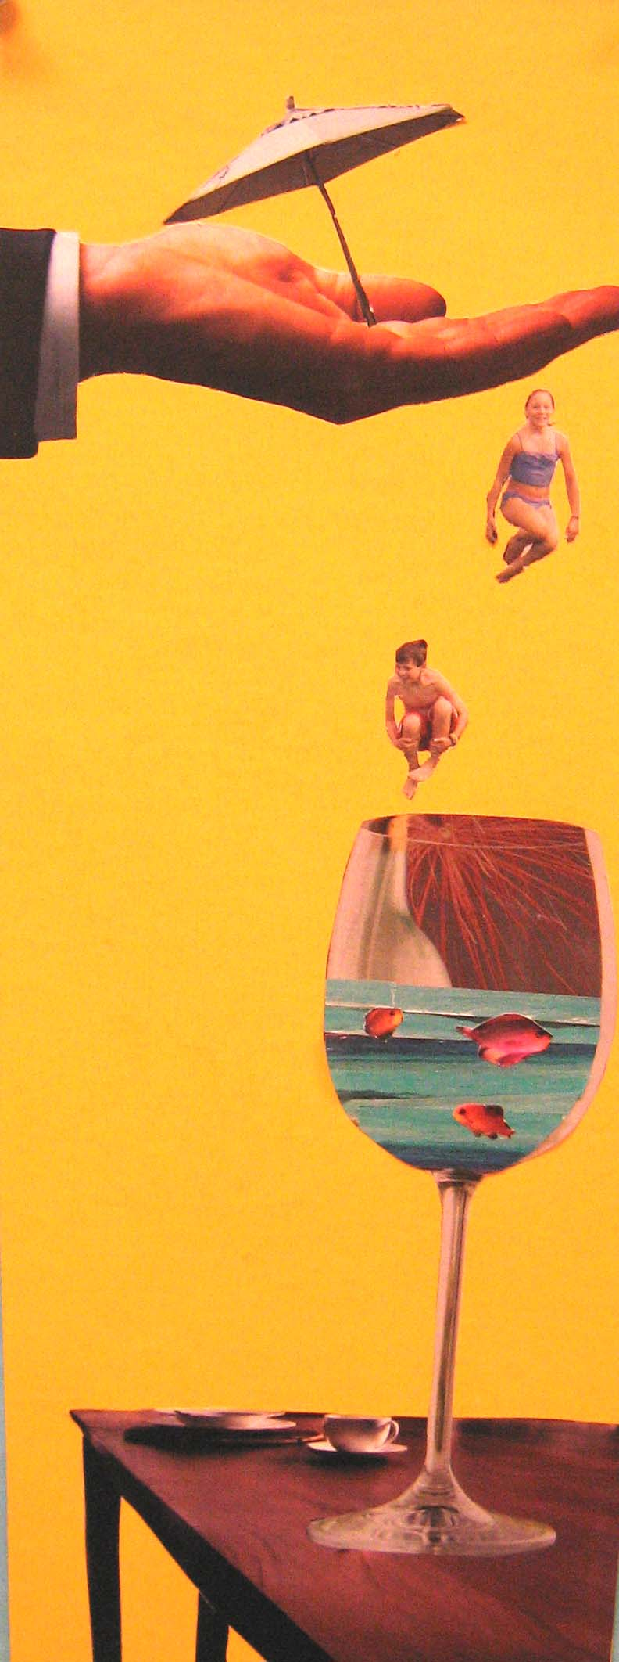
Student Example- Alicia

Slide 28
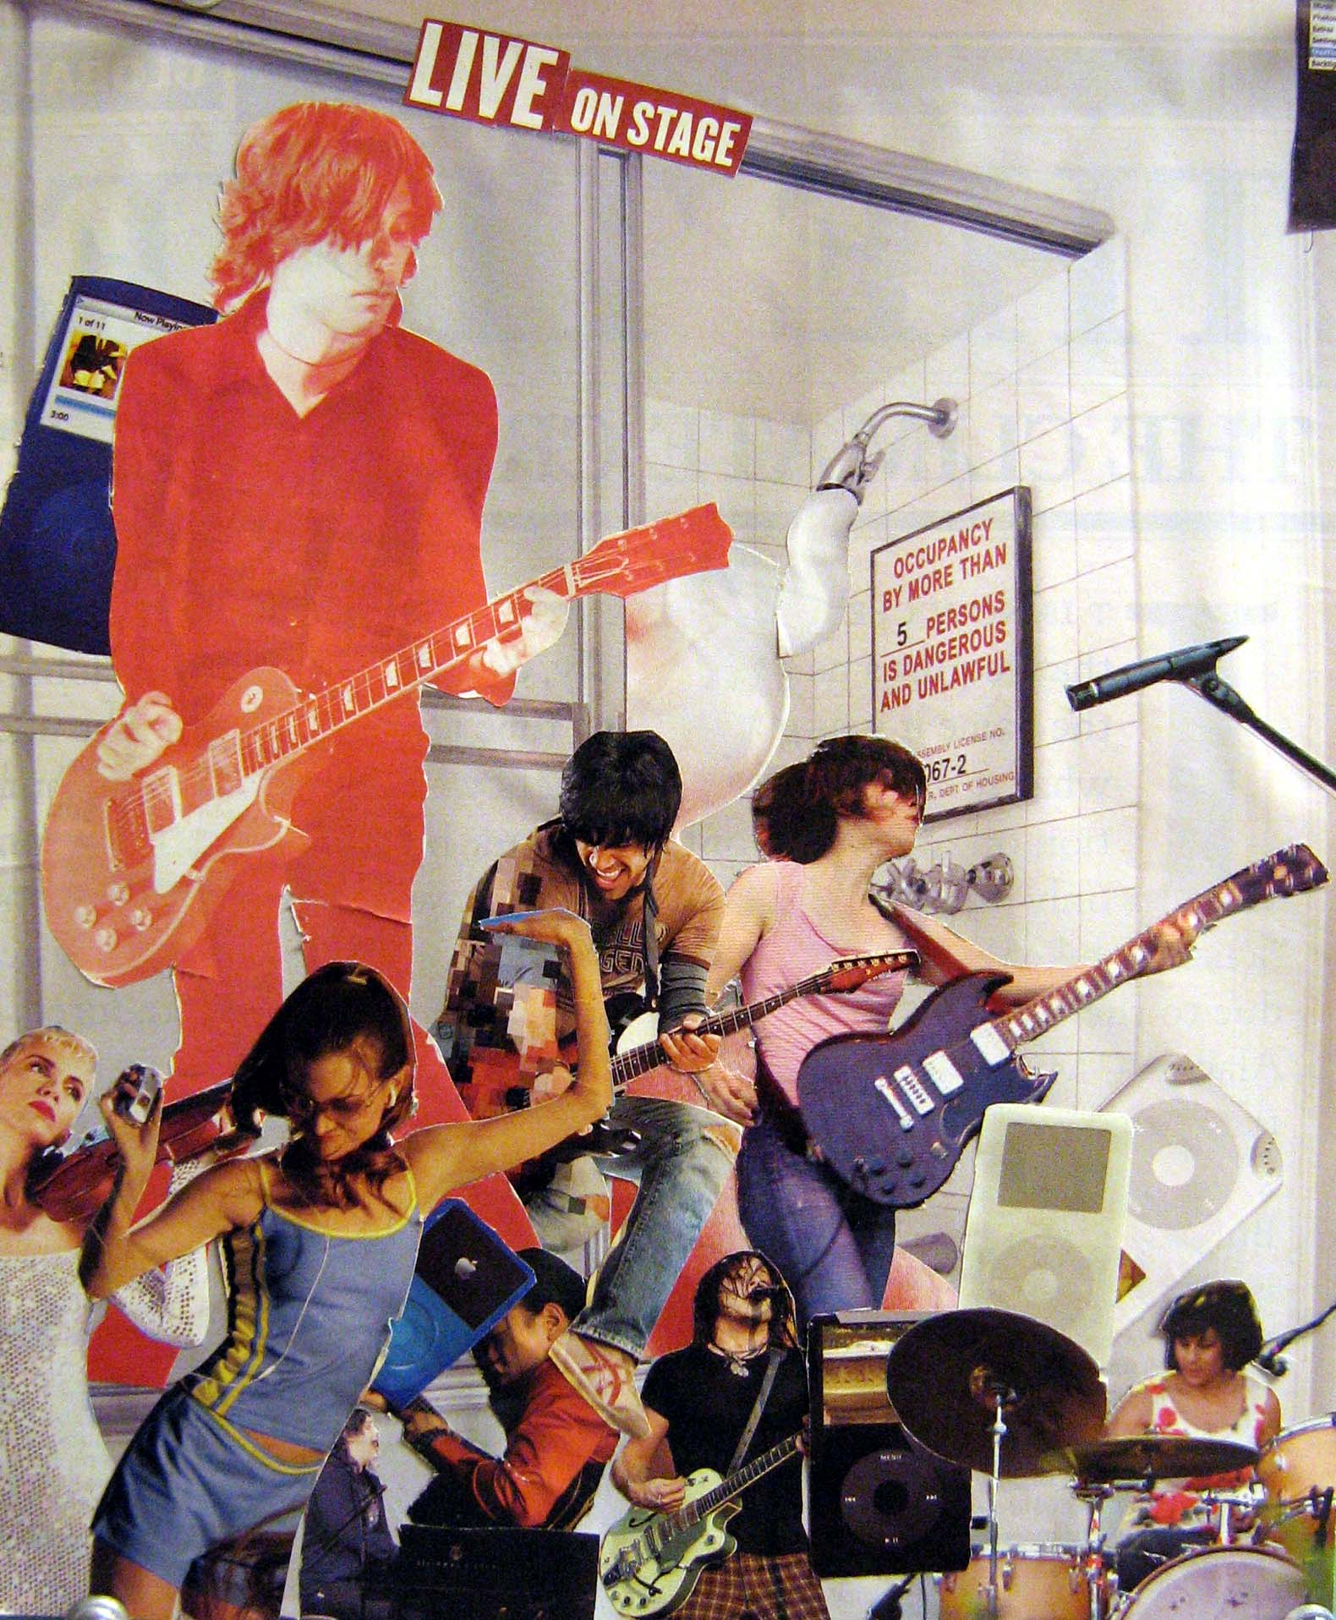
Student Example- Carolyn

Slide 29
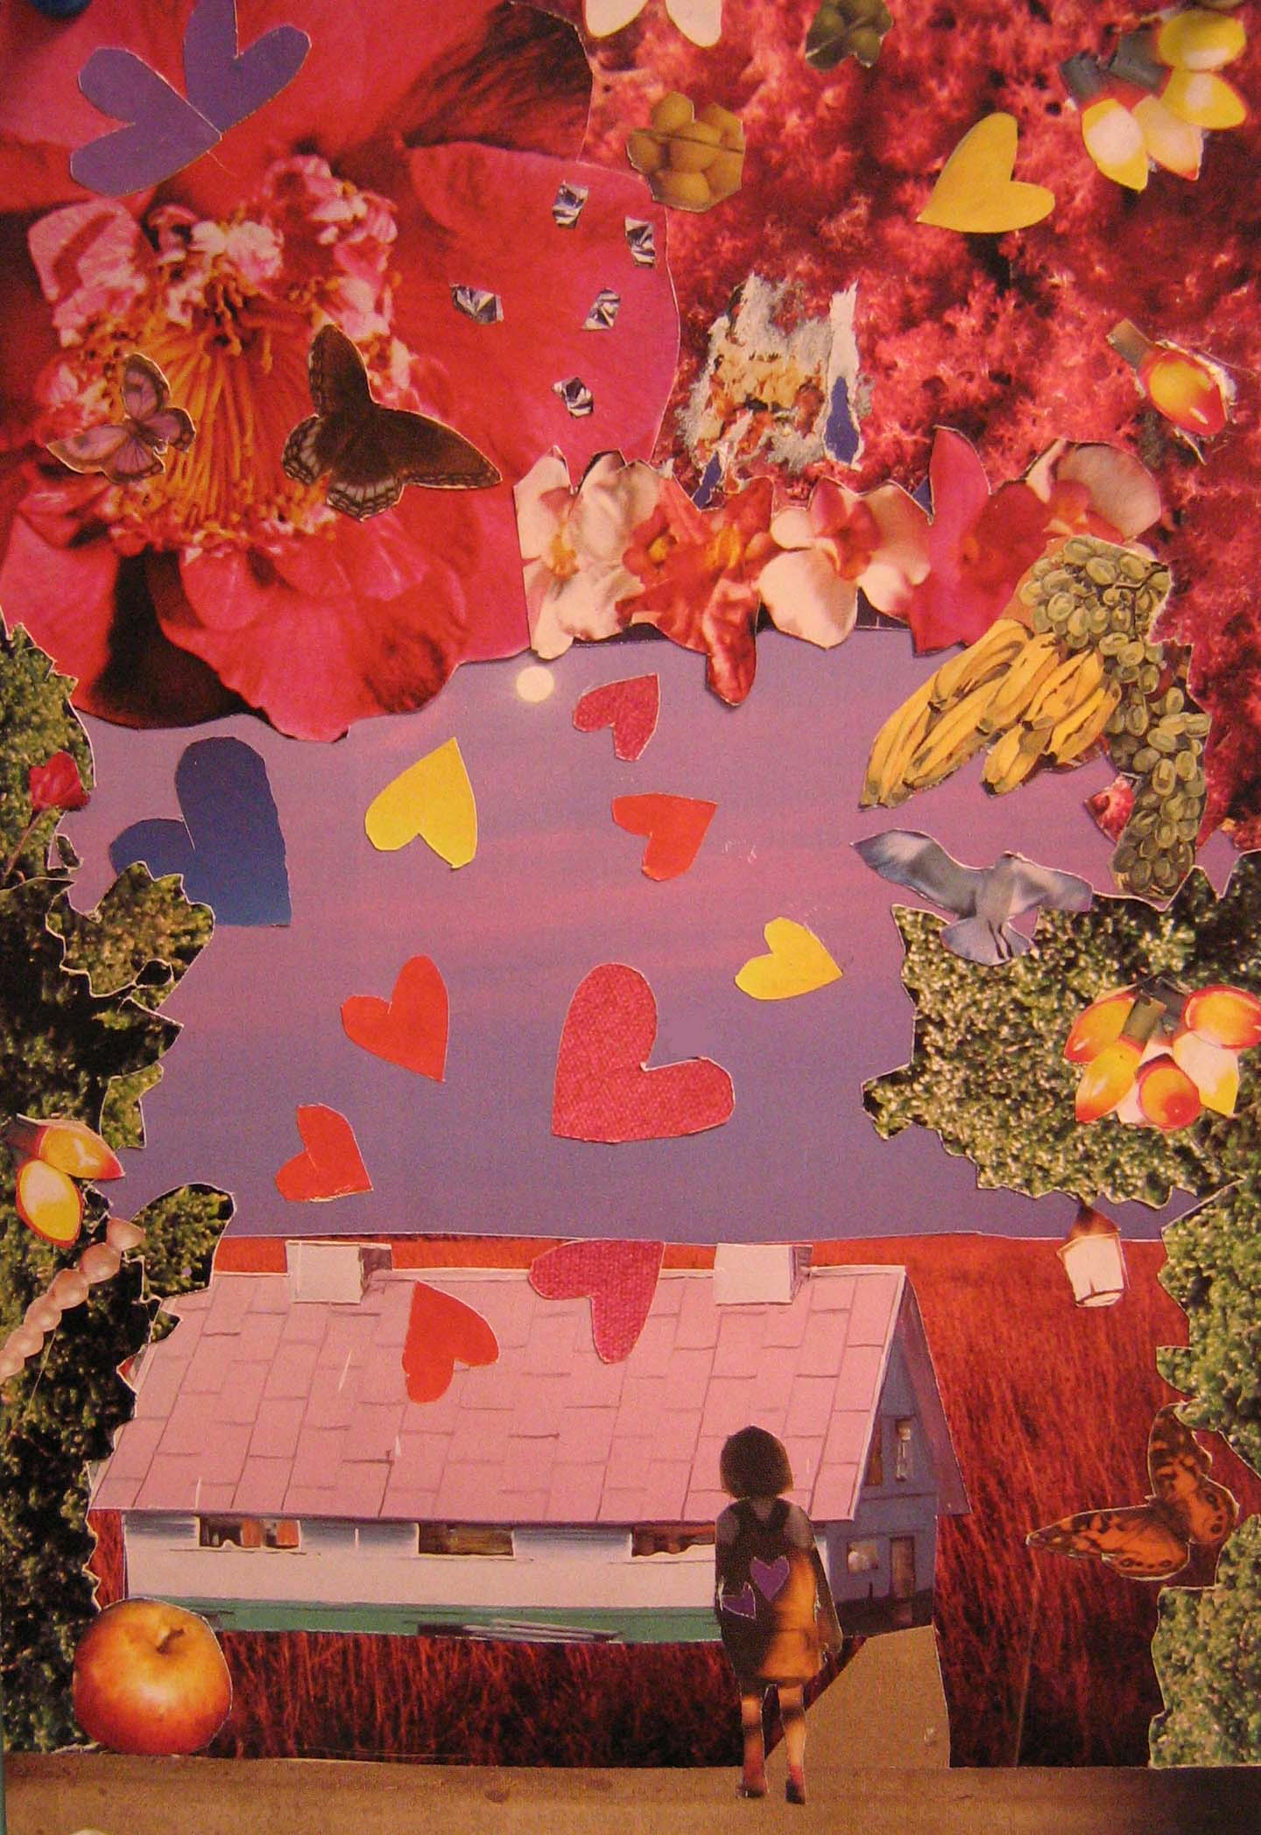
Student Example- Lynne

Slide 30
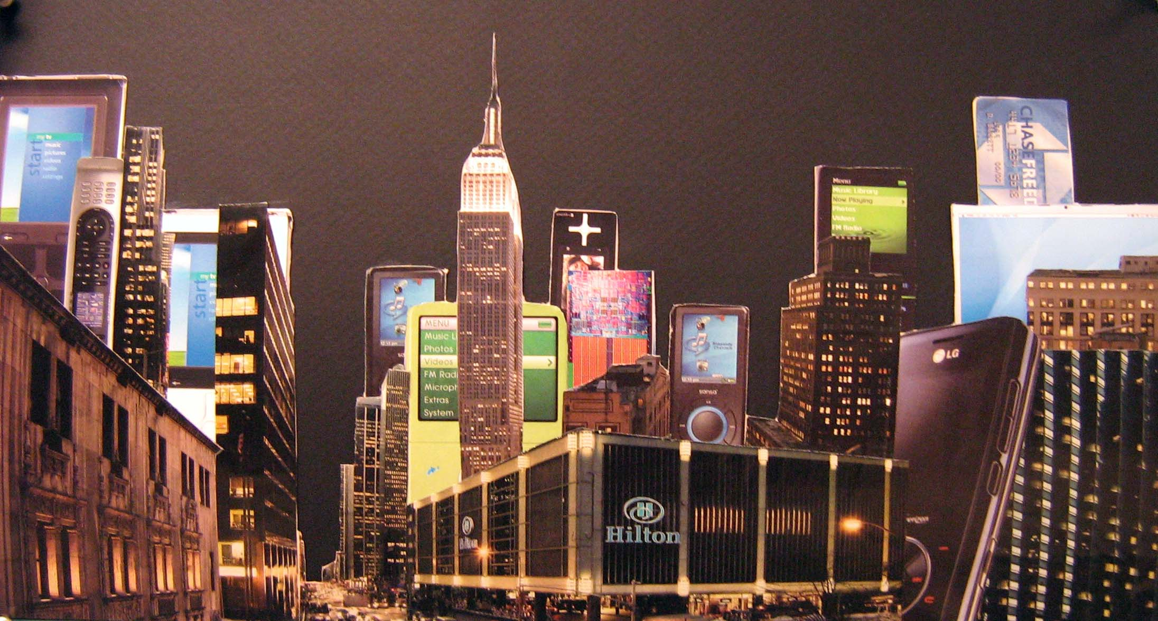
Student Example- Jackie

Slide 31
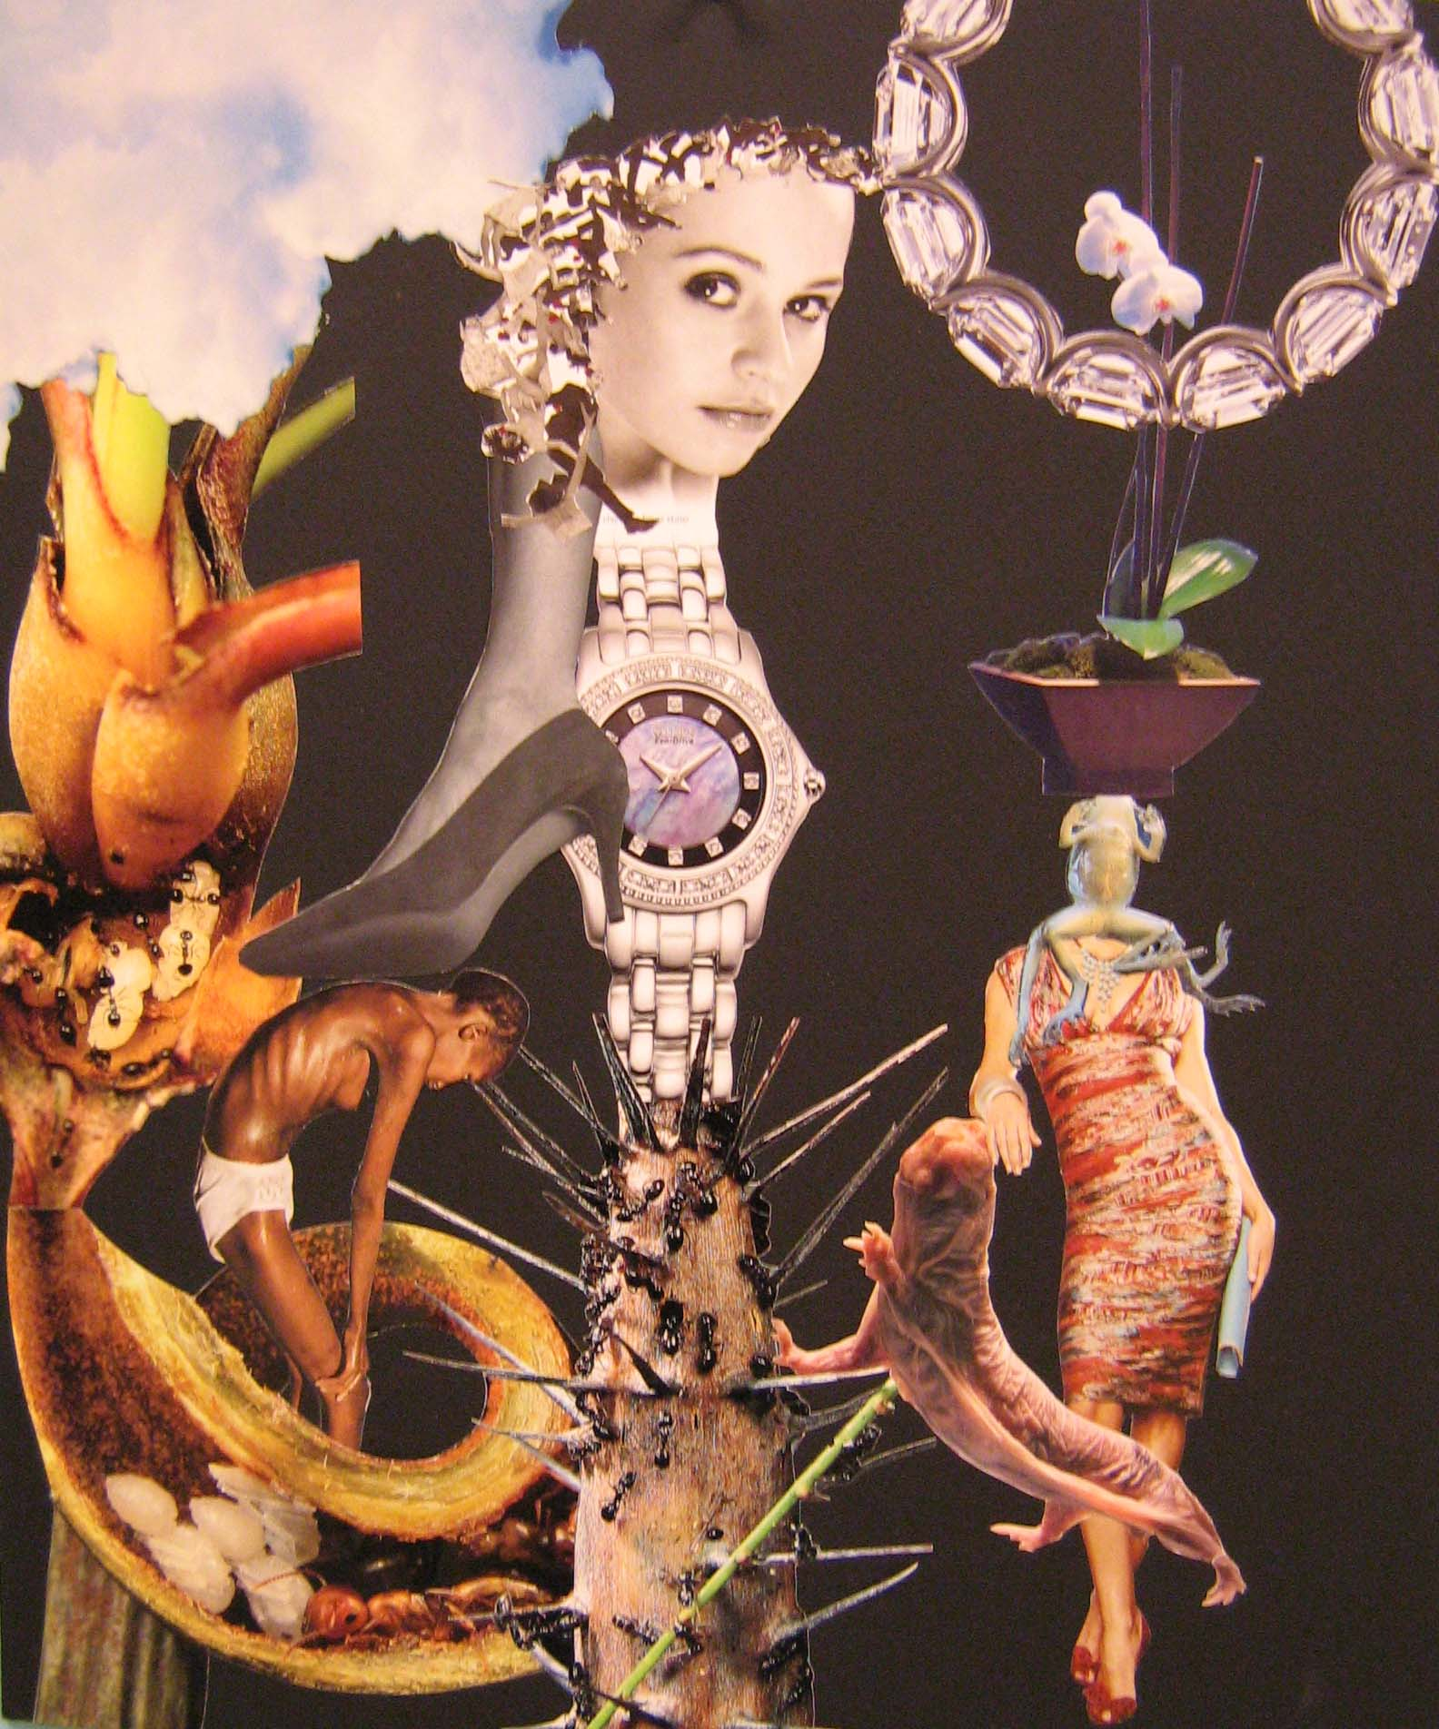
Student Example- Lisa

Slide 32
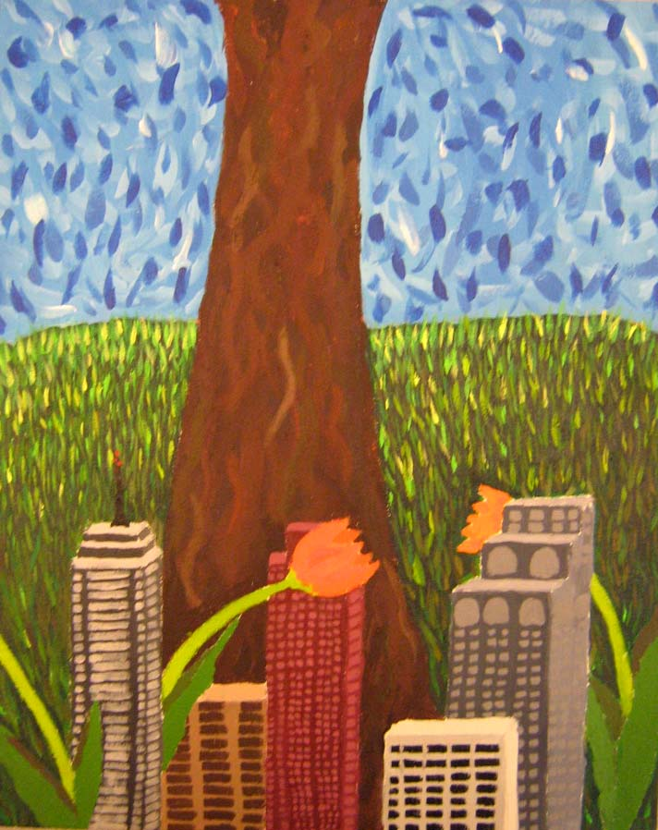
Student Example- Christina

Slide 33
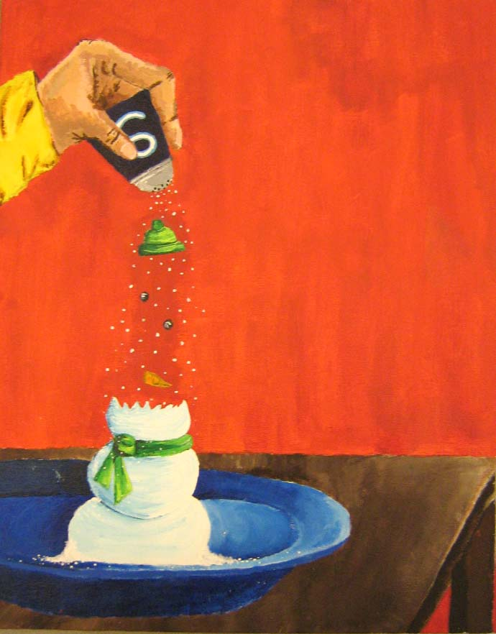
Student Example- Alicia

Slide 34
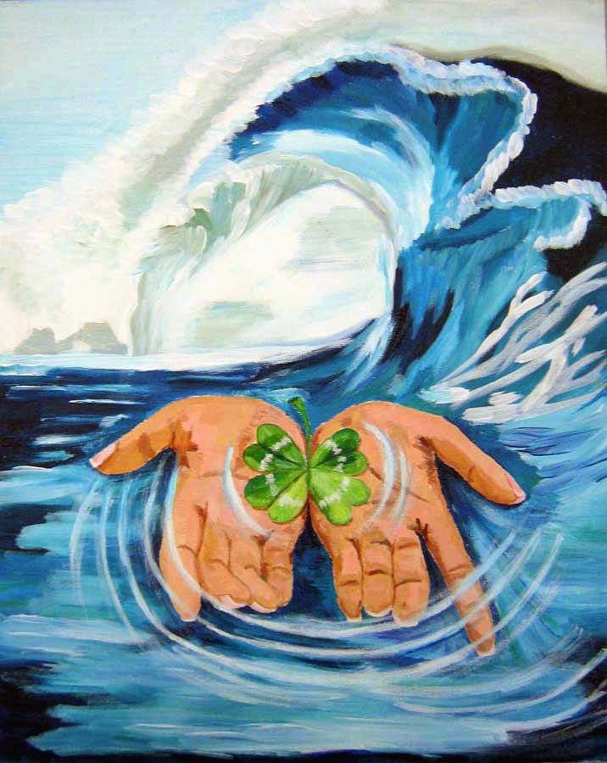
Student Example- Noshin

Slide 35

Student Example- Lisa

Slide 36

Student Example- Renee

Slide 37

Student Example- Stephanie

Slide 38
What is your idea? Start with a well thought-out creative idea. Throwing two random things together doesn’t necessarily qualify as surreal.
Use QUALITY photographic images from magazines- not cartoons or illustrations.
Avoid images from popular culture such as famous people, name brands and retail products that will distract the viewer.
Cut and glue carefully so all images have smooth edges and there is no visible glue.
Consider background, middle ground and foreground.

