Slide 1
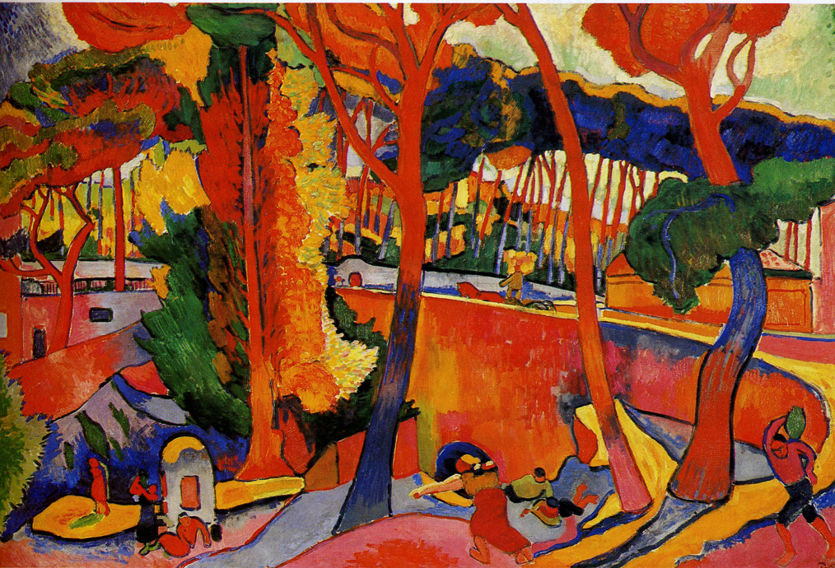
Fauvism by Ashley Fifield

Slide 2
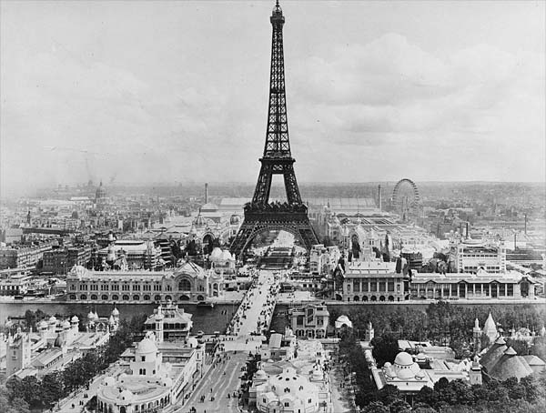
A New Century
Experimentation in all areas
New art styles evolved rapidly
Continued pressure to be part of an artistic tradition
Paris, 1900

Slide 3
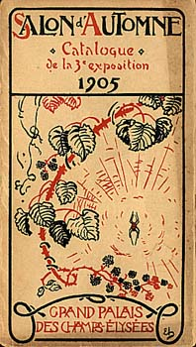
The Wild Beasts
The Salon d’Automne in Paris (1905)
Term “fauves” (wild beasts) first used by art critic
Most wanted pleasant or subdued scenes for wall art
Found paint application unpleasant

Slide 4
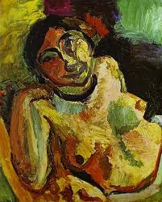
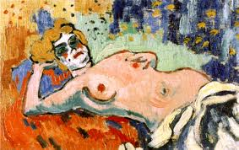
A Movement (sort of)
Originally based on a series of friendships
Never used term “fauve” themselves
Differing styles
Connected by common techniques and concepts
Reclining Nude, 1906 (Vlaminck)
The Gypsy, 1906 (Matisse)

Slide 5
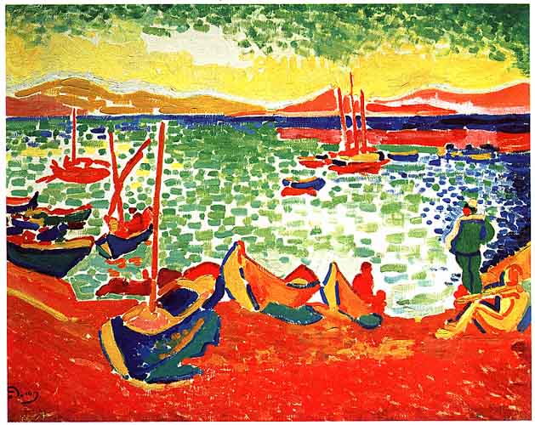
Characteristics
Exaggerated, vibrant color
Use of contrasting colors to create volume and structure
Broad brushstrokes
Moderately thick paint application
Boats at Collioure Harbor, 1905 (Derain)

Slide 6
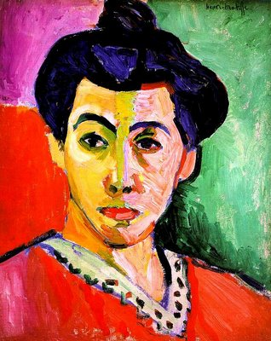
Characteristics (cont.)
Simplified drawing
Solid planes of color
A source of light
Subject matter:
- portrait - still life
- landscape - cityscape
Portrait of Madame Matisse/The Green Line, 1905 (Matisse)

Slide 7
The Idea Behind the Color
Color as the subject (independent of natural appearance)
Art as vehicle for artist’s emotions
Not just piece of art, a journey
Painting autonomous creation
All pictorial elements realized with color
Not represent perceptual world, take viewer beyond reality

Slide 8
Influences
Artists:
- Gustave Moreau - Van Gogh - Cézanne
- Seurat
Movements:
Impressionism - Post-Impressionism
Different Cultures:
- African Sculpture

Slide 9
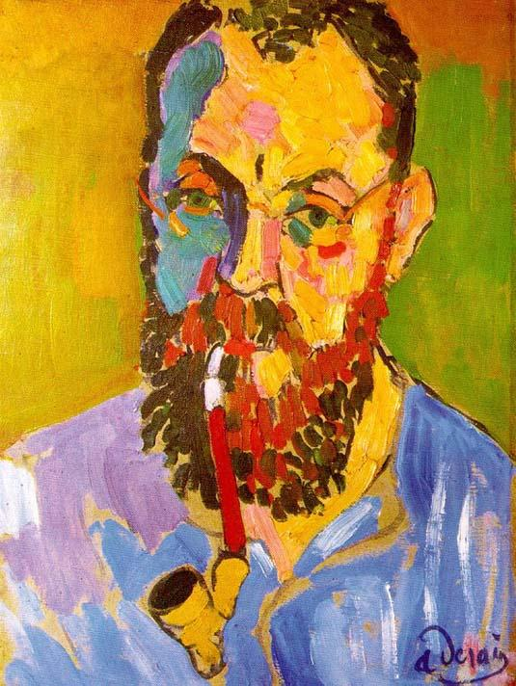
Henri Matisse (1869-1954)
Studied law
Began painting at the age of twenty
Sculptor
Studied under Moreau
Focused on tradition (accepted styles)
Found moderate success
Portrait of Matisse, 1905 (Derain)

Slide 10
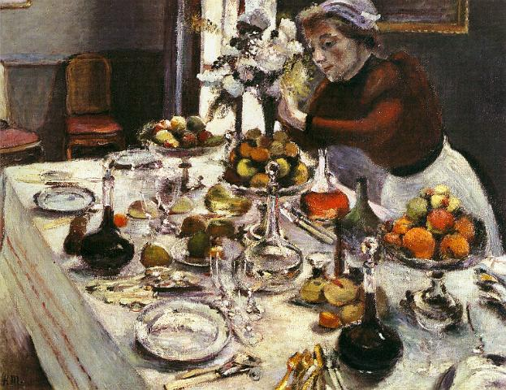
La Desserte, 1896-97 (Matisse)

Slide 11
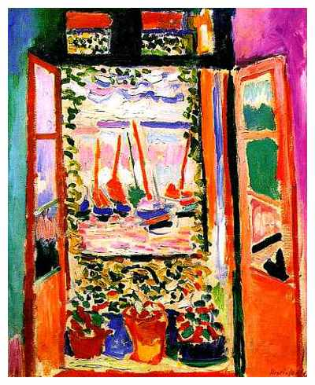
Matisse as a Fauve
The “chief fauve”
1905: Matisse and Derain in Collioure
Preferred the female form (portraits and nudes)
Felt if he intensified the color, he must reduce amount of detail (shapes and form)
The Open Window, Collioure, 1905 (Matisse)

Slide 12
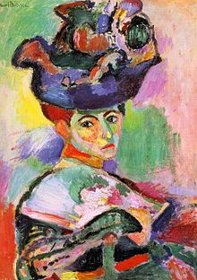
Woman with a Hat, 1905 (Matisse)

Slide 13
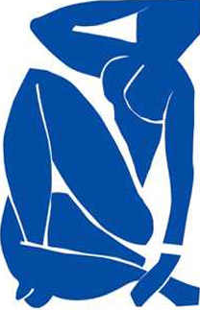
Matisse’s Art After Fauvism
Created simplified forms against flat planes of color
Experimented briefly with Cubism
More interest in sculpture
Collage
Blue Nude III, 1952 (Matisse)

Slide 14
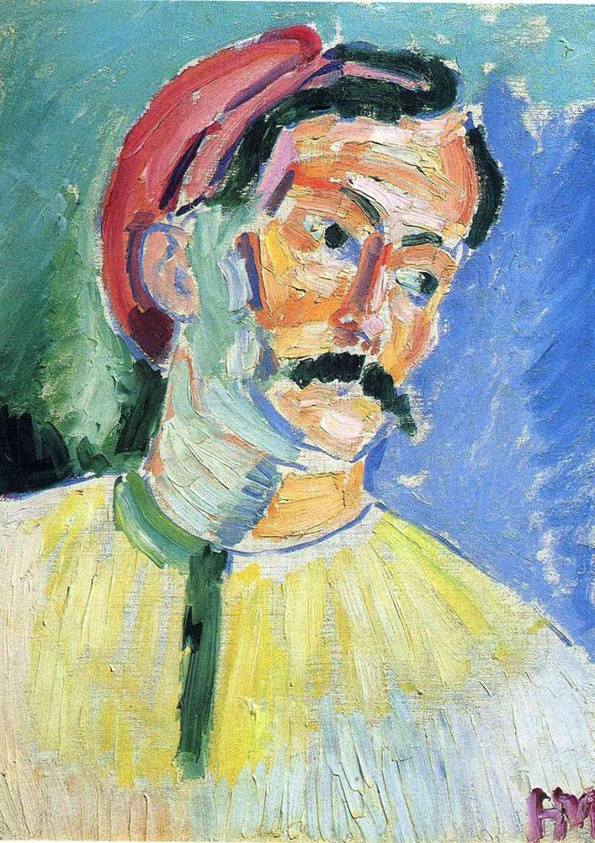
André Derain (1880-1954)
Born in Chatou, a favorite haunt of the Impressionists
Parents didn’t approve of painting as profession (chose engineering)
Met Matisse in 1899; Vlaminck in 1900
Served in the military
Soon after, began studying art
Portrait of Derain, 1905 (Matisse)

Slide 15
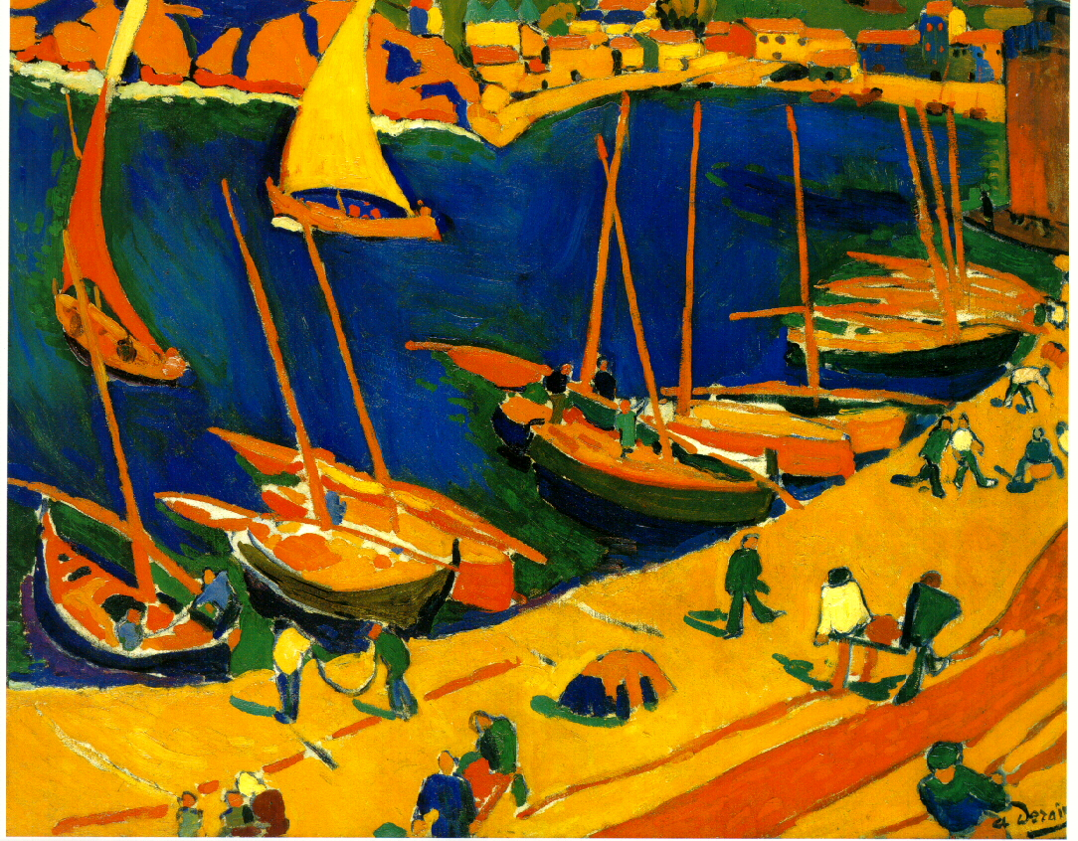
Derain as a Fauvist
Despite enthusiasm for color, still influenced by a more ordered/traditional concept of painting
Fauvist style showcased in series of London paintings, commissioned in 1906
Went to extremes of intensity and anti-naturalism
Collioure, 1905 (Derain)

Slide 16
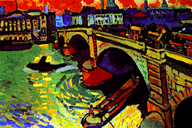
London Bridge, 1906 (Derain)

Slide 17
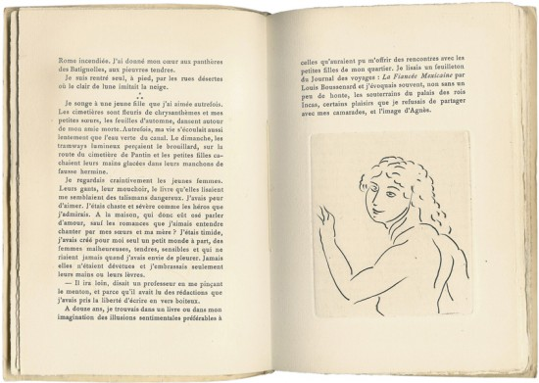
Derain’s Art After Fauvism
Experimented with cubism
By the 1920s, style was increasingly Neoclassical
Destroyed many fauvist pieces; rarely dated paintings and changed the ones he did
Theatrical design
Book illustrations
Le Nez de Cleopatre, 1922. Written by Georges Gabory.

Slide 18
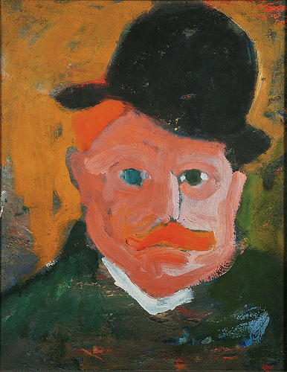
Maurice de Vlaminck (1876-1958)
Served in the military
Was a competitive cyclist, musician, actor, and novelist
Self-taught artist
Liked to boast about his contempt for museums
Met Derain in 1900 (introduced to Matisse)
Portrait of Vlaminck, 1905 (Derain)

Slide 19
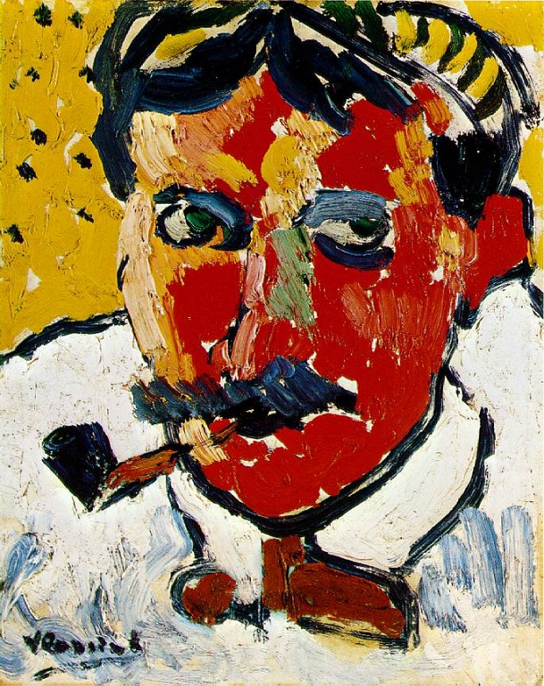
Vlaminck as a Fauvist
Impulsive style
Short, choppy brushstrokes
Like other Fauves, not all use of color was “pure” (example: The Red Trees)
Experimented with pointillism
Portrait of Derain, 1906 (Vlaminck)

Slide 20
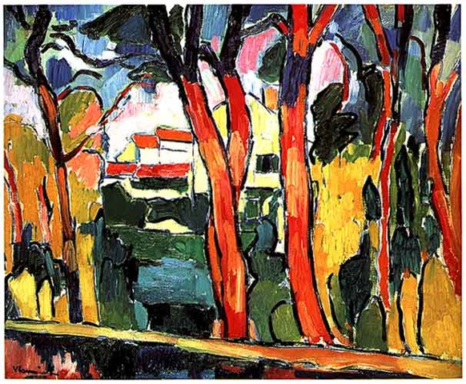
The Red Trees, 1908 (Vlaminck)

Slide 21
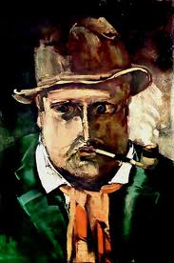
Vlaminck’s Art After Fauvism
Influenced by showing of Cezanne’s work
Introduced darker shades into overall tone
Moved to the country to paint landscapes
Eventually moved away from Cezanne’s influence, to more Classical construction
Self-Portrait, 1910 (Vlaminck)

Slide 22
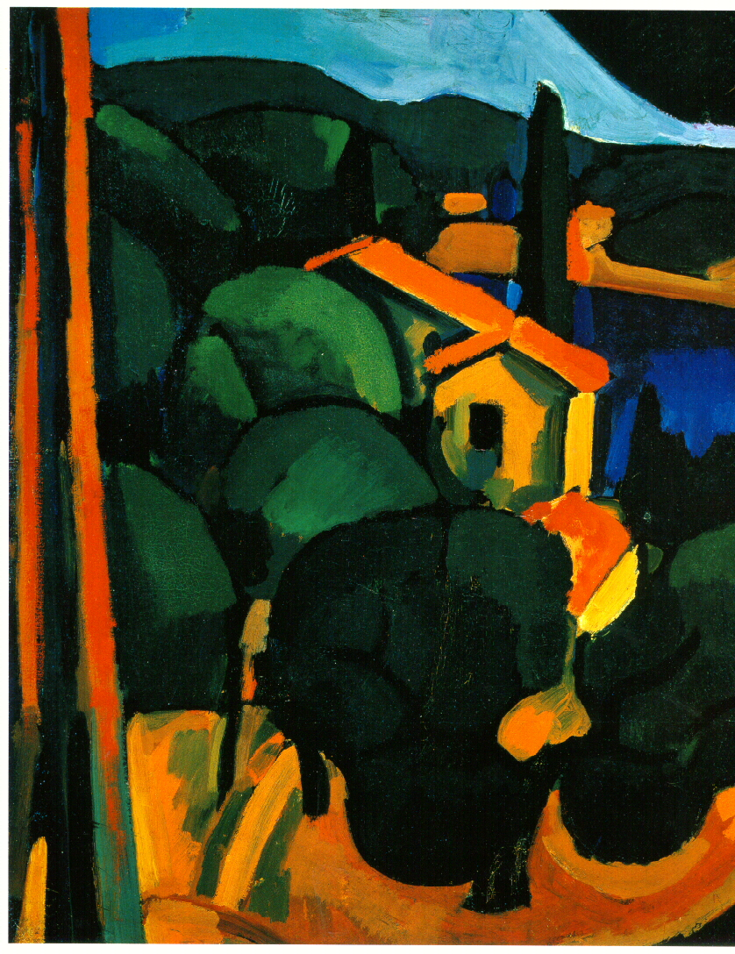
Fauvism Draws to a Close
Lost momentum by 1908
Environment of experimentation also meant styles quickly developed, then were often quickly modified or abandoned
Nearly all of the Fauves branched out from Fauvism
Paysage a Cassis, 1907 (Derain)

Slide 23
Fauvism’s Influence
Made impression on artists, from many different countries, that were drawn to Paris during period of development
Liberated use of color for future movements
Freed painting from serving symbolic or narrative ends
Extended boundaries of representation
Techniques adopted and developed by German Expressionists

